Slide 1
Human Computer Interaction
Evaluations – Heuristics

Slide 2
Heuristics
Heuristics (which you might also find named “rules of thumb”) are a well-established, proven set of guidelines that tend to result in good interface design when adhered to.

Slide 3
Heuristic Evaluation
A heuristic evaluation is a usability inspection method for computer software that helps to identify usability problems in the user interface (UI) design.

Slide 4
Evaluation Methods
Design-oriented evaluation methods:
  Heuristic/expert inspections
  Cognitive walkthrough
Notes:
The cognitive walkthrough is a usability evaluation method in which one or more evaluators work through a series of tasks and ask a set of questions from the perspective of the user. The focus of the cognitive walkthrough is on understanding the system's learnability for new or infrequent users.

Slide 5
Heuristic/Expert Inspections
A number of experts assess the usability of an interface guided by usability principles and guidelines (heuristics) because it is very likely that one person will not be able to find all usability problems.
Suited to early design when representation/prototype is available
It’s only as good as the experts you can afford

Slide 6
Heuristic Evaluation Process
Briefing session
Evaluation period
Debriefing session

Slide 7
1 – Briefing Session
Briefing session
  Several experts
  All are given identical description of product, its context of use and the goals of evaluation

Slide 8
2 – Evaluation
How does it work?
  Evaluators use a checklist of basic usability heuristics
  Evaluators go through an interface twice
    1st pass get a feel for the flow and general scope
    2nd pass refer to checklist of usability heuristics and focus on individual elements
  The findings of evaluators are combined and assessed

Slide 9
Severity Ratings
Severity ratings can help prioritize the fixing of usability problems.
After evaluation sessions, a complete aggregate list of usability problems is given/sent to each evaluator.
Working independently, evaluators assign severity rating [on scale of 0–4] to each problem.
Severity rating of single evaluator is unreliable, mean of 3–5 evaluators is satisfactory.
Score | Severity
0 | I don’t agree that this is a usability problem at all. This is usually considered a suggestion then.
1 | Cosmetic problem only: need not be fixed unless extra time is available on project
2 | Minor usability problem: fixing this should be given low priority
3 | Major usability problem: important to fix, so should be given high priority
4 | Usability catastrophe: imperative to fix this before product can be released
Notes:
Severity ratings can be used to allocate the most resources to fix the most serious problems and can also provide a rough estimate of the need for additional usability efforts. If the severity ratings indicate that several disastrous usability problems remain in an interface, it will probably be unadvisable to release it. But one might decide to go ahead with the release of a system with several usability problems if they are all judged as being cosmetic in nature.
https://www.nngroup.com/articles/how-to-rate-the-severity-of-usability-problems/
The severity of a usability problem is a combination of three factors:
The frequency with which the problem occurs: Is it common or rare?
The impact of the problem if it occurs: Will it be easy or difficult for the users to overcome?
The persistence of the problem: Is it a one-time problem that users can overcome once they know about it or will users repeatedly be bothered by the problem?

Slide 10
3 – Debriefing Session
Debriefing session
  Experts meet to compare findings and propose solutions
  They report/present their findings to decision makers and other stakeholders

Slide 11
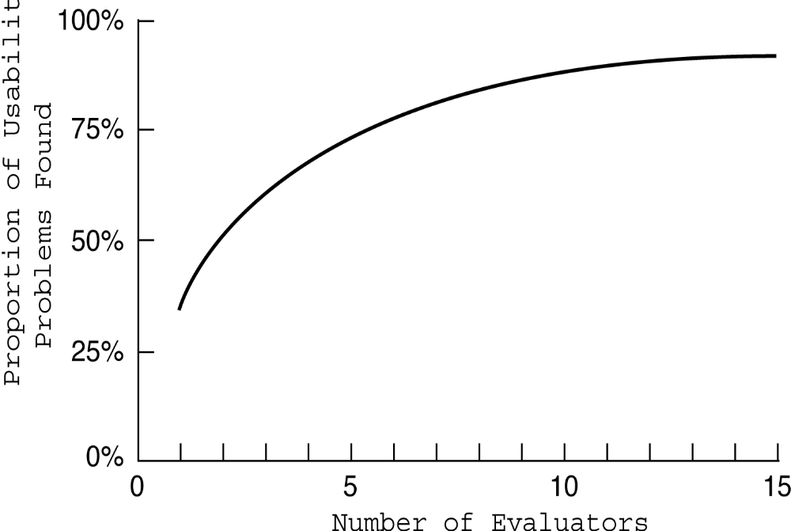
No. of evaluators & problems
Notes:
11

Slide 12
Nielsen’s Ten Heuristics
Visibility of system status
Match between system and the real world
User control and freedom
Consistency and standards
Recognition rather than recall
Flexibility and efficiency of use
Aesthetic and minimalist design
Error prevention
Help users recognize, diagnose and recover from errors
Help and documentation

Slide 13
Nielsen’s Ten Heuristics
Visibility of system status [Feedback]
    Always keep users informed about what is going on, through appropriate feedback within reasonable time. For example, if a system operation will take some time, give an indication of how long and how much is complete.
  For example: busy cursor [1–10s], progress indicator [>10s].

Slide 14



1. Provide feedback
Continuously inform the user about
  what it is doing
  how it is interpreting the user’s input
  user should always be aware of what is going on
What’s it doing?
Time for coffee.
> Doit
> Doit
This will take
5 minutes...

Slide 15
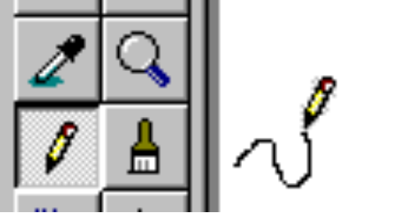
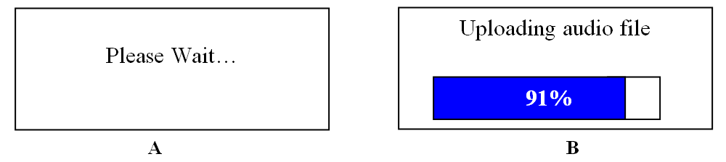
1. Provide feedback
What mode am I in now?
How is the system interpreting my actions?
What did I select?

Slide 16
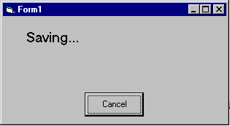
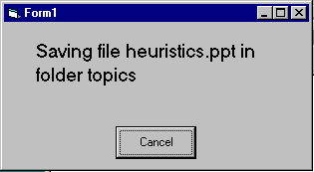
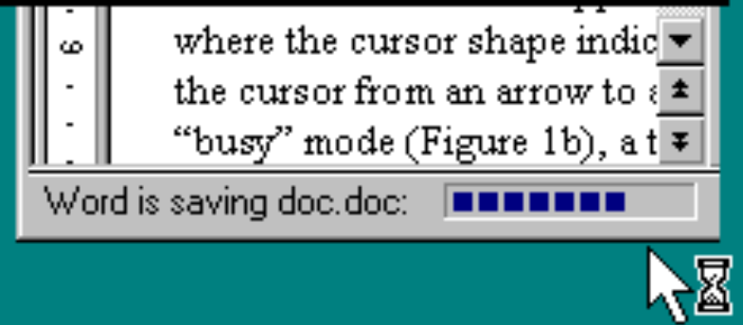
1. Provide feedback
Be as specific as possible, based on user’s input
Best within the context of the action

Slide 17
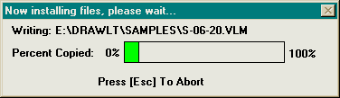
1. Provide feedback
Multiple files being copied,
but feedback is file by file.

Slide 18
1. Provide feedback
Response time
  how users perceive delays
    <0.1s perceived as “instantaneous”
    1s user’s flow of thought stays uninterrupted, but delay noticed
    10s limit for keeping user’s attention focused on the dialog
    > 10s user will want to perform other tasks while waiting

Slide 19
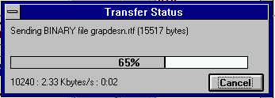
1. Provide feedback
Dealing with long delays
  Cursors
    for short transactions
  Percent done dialogs
      time left
      estimated time
  Random
    for unknown times
Contacting host (10-60 seconds)
cancel

Slide 20
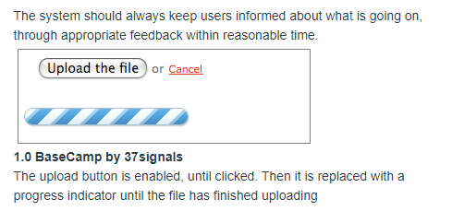
1. Provide feedback

Slide 21
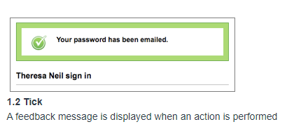
1. Provide feedback

Slide 22
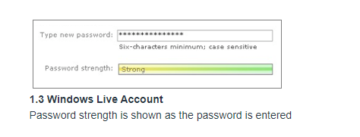
1. Provide feedback

Slide 23
Nielsen’s Ten Heuristics
Match between system and the real world [Speak the Users’ Language]
  The system should speak the user’s language, with words, phrases and concepts familiar to the user, rather than system-oriented terms. Follow real-world conventions, making information appear in natural and logical order.
  Match users’ mental model.

Slide 24




2. Speak the users’ language
My program gave me the message Rstrd Info.
What does it mean?
That’s restricted information
No, no… Rsdrd Info stands for “Restricted Information”
But surely you can tell me!!!
Hmm… but what does it mean???
It means the program is too busy to let you log on
Ok, I’ll take a coffee

Slide 25
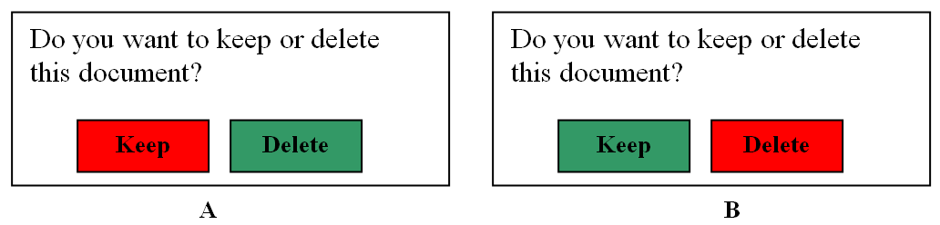
2. Speak the users’ language
Match between system and the real world

Slide 26
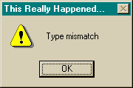
2. Speak the users’ language
Match between system and the real world

Slide 27
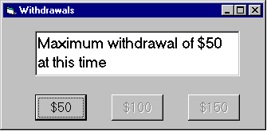
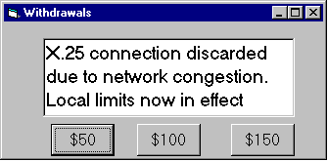

2. Speak the users’ language
Terminology based on users’ language for task
  e.g. withdrawing money from a bank machine
    (tooltip icon)

Slide 28
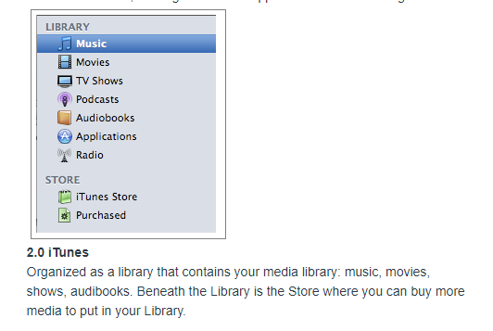
2. Speak the users’ language

Slide 29
Nielsen’s Ten Heuristics
User control and freedom [Clearly Marked Exits]
  Users often choose system functions by mistake and need a clearly marked ‘emergency exit’ to leave the unwanted state without having to go through an extended dialog. Support undo and redo.

Slide 30
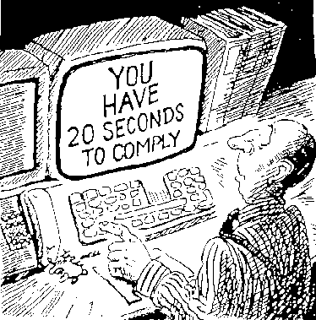
3. Provide clearly marked exits
How do I get out of this?

Slide 31
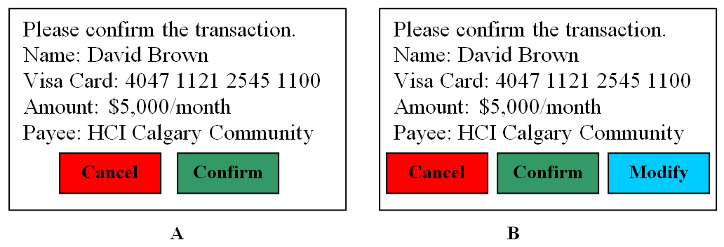
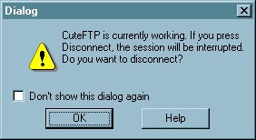
3. Provide clearly marked exits

Slide 32
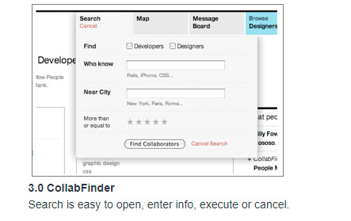
3. Provide clearly marked exits

Slide 33
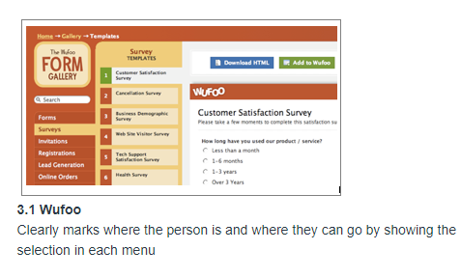
3. Provide clearly marked exits

Slide 34
3. Provide clearly marked exits
Users don’t like to feel trapped by the computer!
  should offer an easy way out of as many situations as possible
Strategies:
  Cancel button (for dialogs waiting for user input)
  Universal Undo (can get back to previous state)
  Interrupt (especially for lengthy operations)
  Quit (for leaving the program at any time)
  Defaults (for restoring a property sheet)

Slide 35
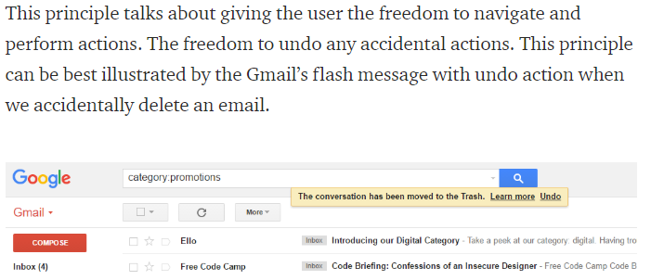

Slide 36
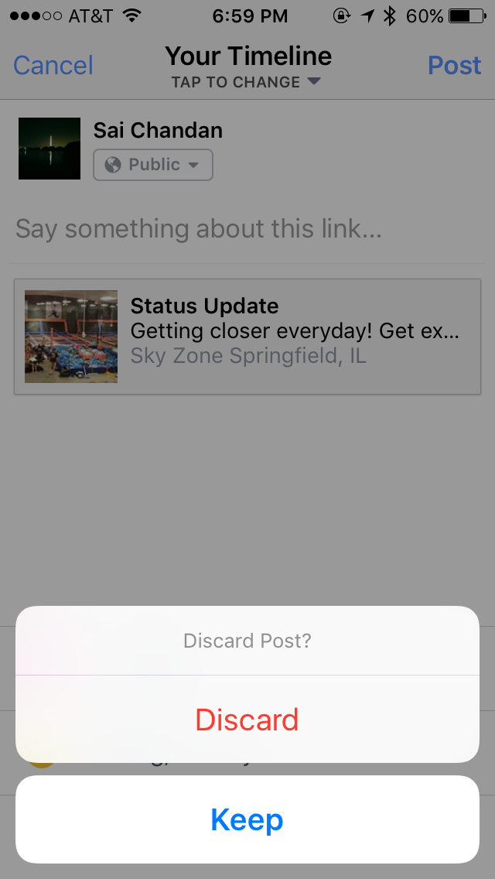
Notes:
Facebook checking on me if I tapped “Cancel” by mistake.

Slide 37
Nielsen’s Ten Heuristics
Consistency and standards
  Users should not have to wonder whether words, situations or actions mean the same thing in different contexts. Follow platform conventions and accepted standards.
Principle of Least Surprise
Consistency
  Internal
  External
Notes:
If a necessary feature has a high astonishment factor, it may be necessary to redesign the feature
In Windows operating systems and some desktop environments for Linux, the F1 function key typically opens the help program for an application. A similar keyboard shortcut in macOS is ⌘ Command+⇧ Shift+/. Users expect a help window or context menu when they press the usual help shortcut key(s). Software that instead uses this shortcut for another feature is likely to cause astonishment if no help appears. Malware may exploit user familiarity with regular shortcuts.

Slide 38
4. Be consistent
Consistent syntax of input
Consist language and graphics
  same visual appearance across the system (e.g. widgets)
  same information/controls in same location on all windows
Consist effects
  commands, actions have same effect in equivalent situations
Ok
Cancel
Cancel
Ok
Ok
Accept
Dismiss
Cancel

Slide 39
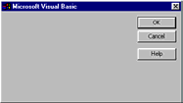
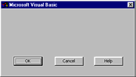
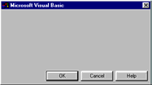
4. Be consistent

Slide 40
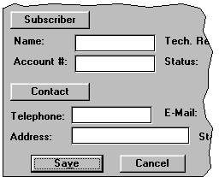
4. Be Consistent
These are labels with a raised appearance.
Is it any surprise that people try and click on them?

Slide 41
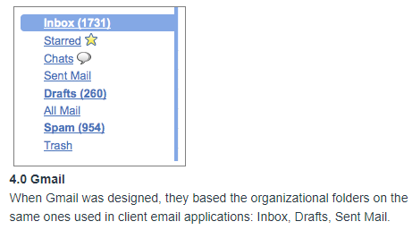
4. Be Consistent

Slide 42
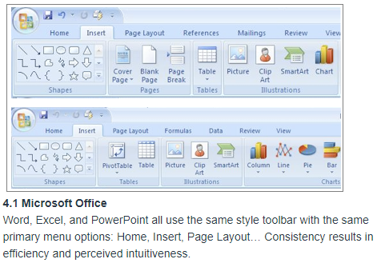
4. Be Consistent

Slide 43
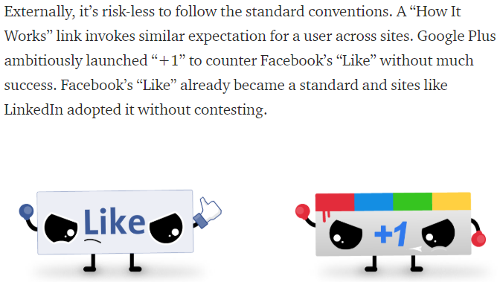
4. Be Consistent

Slide 44
Nielsen’s Ten Heuristics
Recognition rather than recall
  Make objects, actions and options visible. The user should not have to remember information from one part of the dialog to another. Instructions for use of the system should be visible or easily retrievable whenever appropriate.
  Users’ short-term memory is limited. Provide examples, default values, easily retrievable instructions.

Slide 45
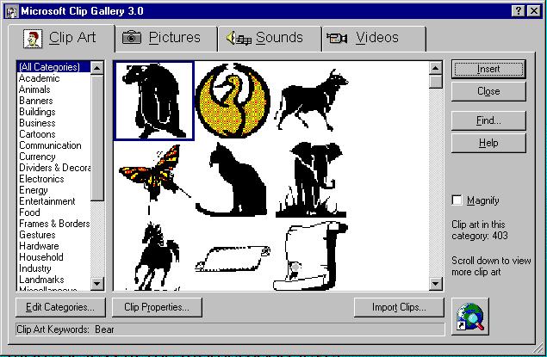
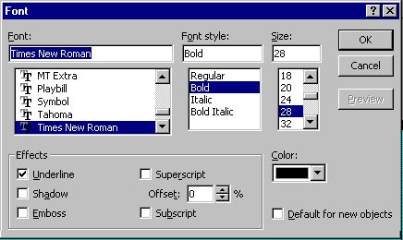
5. Minimize user’s memory load
Computers good at remembering, people are not!
Promote recognition over recall
  menus, icons, choice dialog boxes vs commands, field formats
  relies on visibility of objects to the user

Slide 46
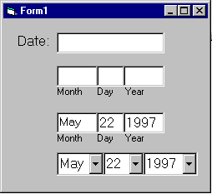
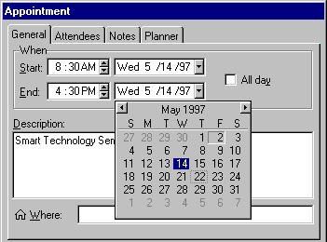
5. Minimize user’s memory load
Gives input format, example and default

Slide 47
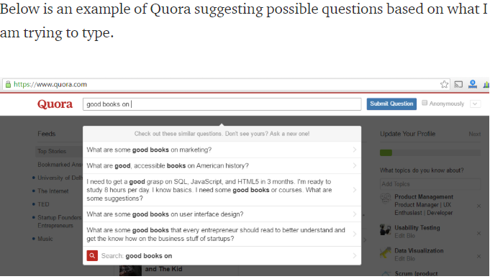
5. Minimize user’s memory load

Slide 48
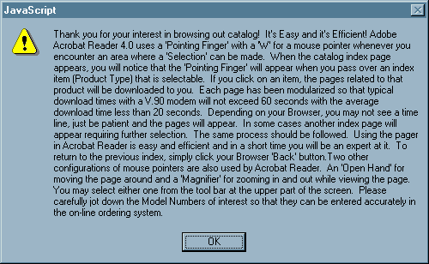
5. Minimize user’s memory load

Slide 49
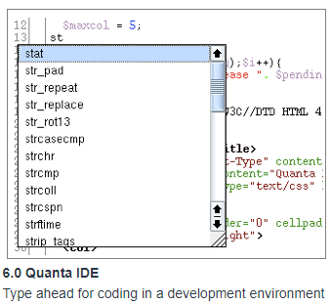
5. Minimize user’s memory load

Slide 50
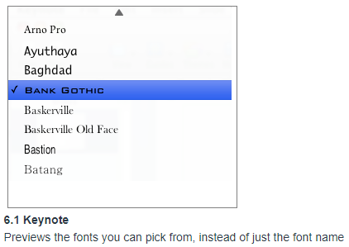
5. Minimize user’s memory load

Slide 51
Nielsen’s Ten Heuristics
Flexibility and efficiency of use
The Interface should be flexible transforming itself between a novice user and an advanced user.
Example : One frequents this option while installing a new software that asks if the user wants to go ahead with default installation or custom installation. An advanced user chooses a custom installation to cut out the unnecessary services.

Slide 52
Nielsen’s Ten Heuristics
Flexibility and efficiency of use [Accelerators]
  Allow users to tailor frequent actions. Accelerators – unseen by the novice user – may often speed up the interaction for the expert user to such an extent that the system can cater to both inexperienced and experienced users.
  For example: command keys, type-ahead, edit and reissue previous commands, menu of most recently used files

Slide 53
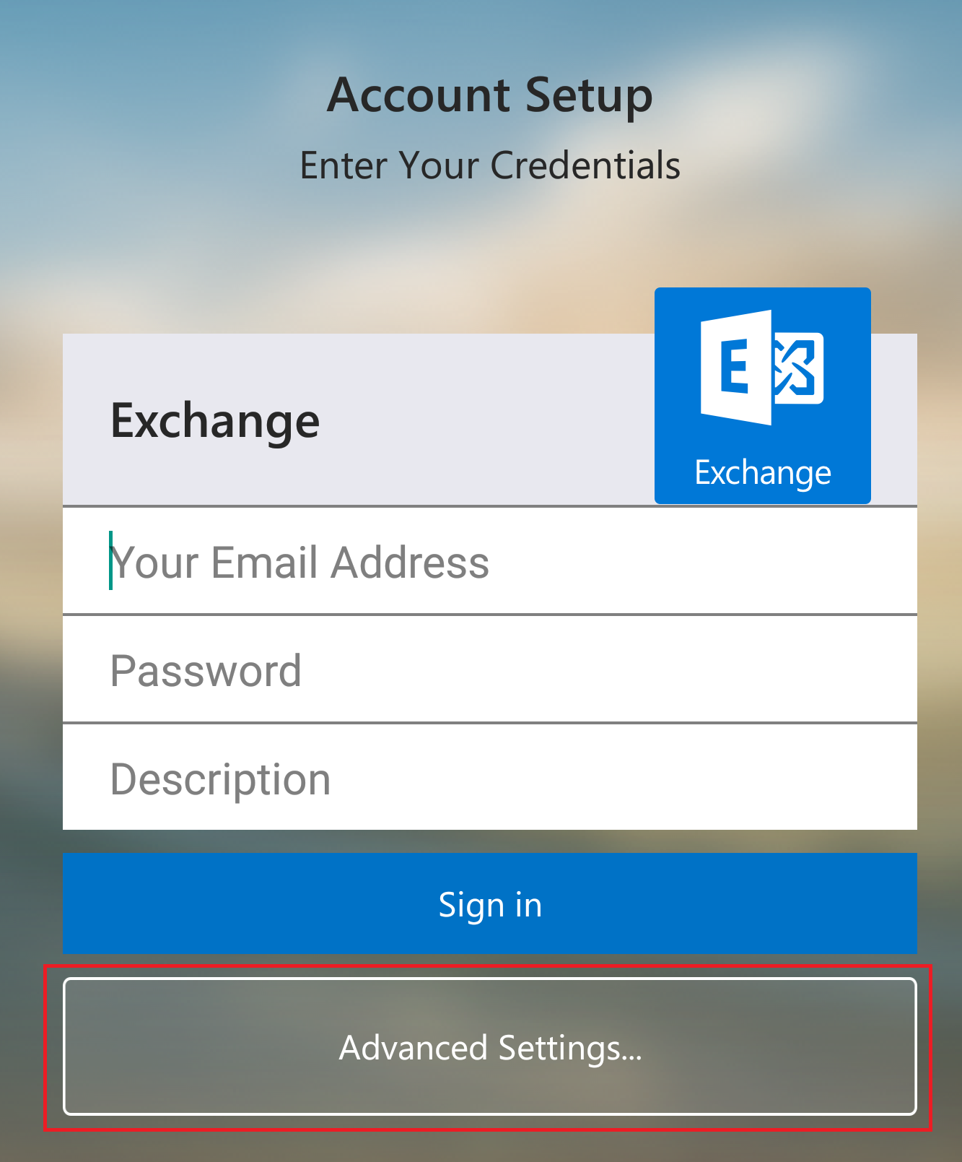
Example of setting up Exchange on Android which hides the complex features under Advanced.

Slide 54
6. Provide shortcuts
Experienced users - perform frequent operations quickly
Strategies:
  keyboard and mouse accelerators
    Short cuts
    function keys
  type-ahead (entering input before the system is ready for it)
  navigation jumps
    e.g., going to window/location directly, and avoiding intermediate nodes
  history systems
    WWW: ~60% of pages are revisits

Slide 55
6. Provide shortcuts
Ctrl
C
Copy

Slide 56
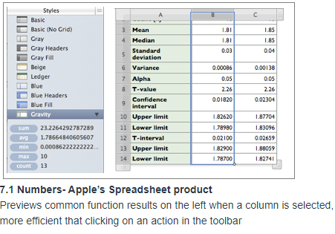

Slide 57
Nielsen’s Ten Heuristics
Aesthetic and minimalist design
  Dialogs should not contain information that is irrelevant or rarely needed. Every extra unit of information in a dialog competes with the relevant units of information and diminishes their relative visibility.

Slide 58
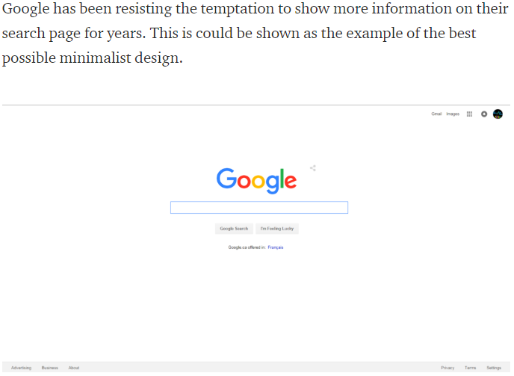
7. Minimalist Design

Slide 59
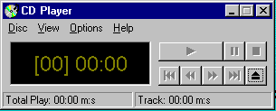
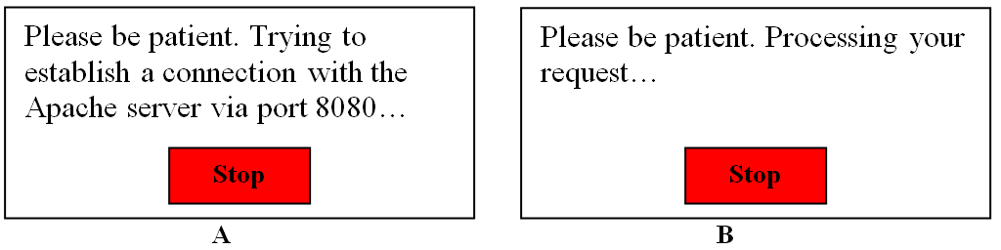
7. Minimalist Design
  match the users’ task sequence
  minimize mapping between interface and task semantics

Slide 60
7. Minimalist Design
Present exactly the information the user needs
  less is more
    less to learn, to get wrong, to distract...
  information should appear in natural order
    related information is graphically clustered
    order of accessing information matches user’s expectations
  remove or hide irrelevant or rarely needed information
    competes with important information on screen
  use windows sparingly
    don’t add unneeded navigation and window management

Slide 61
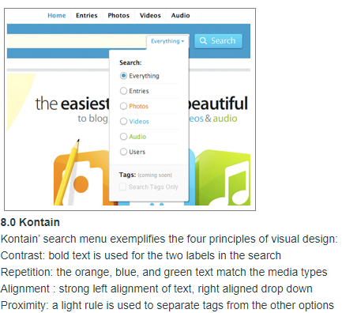
7. Minimalist Design

Slide 62
7. Minimalist Design

Slide 63
Nielsen’s Ten Heuristics
Error prevention
  Make it difficult to make errors. Even better than good error messages is a careful design that prevents a problem from occurring in the first place.
  For example: select file from menu rather than typing in name, confirmation before dangerous actions, avoid similar command names, warning if Caps Lock is activated when entering a password, etc.

Slide 64
8. Prevent Errors
Prevent errors
  try to make errors impossible
  modern widgets: can only enter legal data
Provide reasonableness checks on input data
  on entering order for office supplies
    5000 pencils is an unusually large order. Do you really want to order that many?

Slide 65
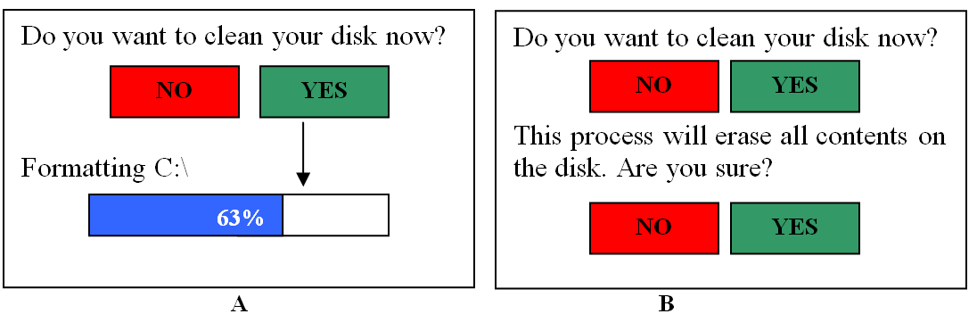
8. Prevent Errors

Slide 66
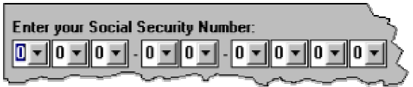
8. Prevent Errors

Slide 67
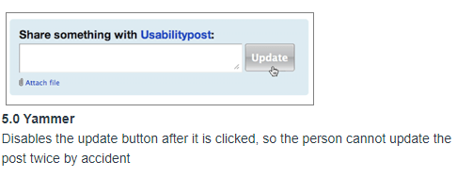
8. Prevent Errors

Slide 68
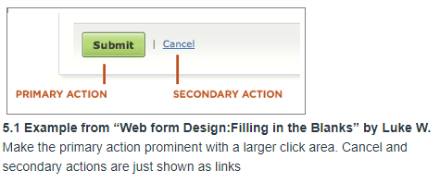
8. Prevent Errors

Slide 69
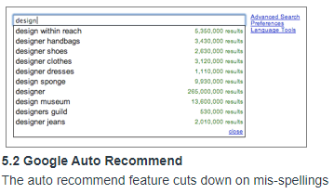
8. Prevent Errors

Slide 70
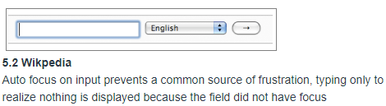
8. Prevent Errors

Slide 71

8. Prevent Errors

Slide 72
Nielsen’s Ten Heuristics
Help users recognize, diagnose and recover from errors [Good Error Messages]
  Error messages should be expressed in plain language (no codes), precisely indicate the problem, and constructively suggest a solution.
  Phrase error messages defensively, never blame the user. Multilevel messages. Link to help system.

Slide 73

Help users recognize, diagnose and recover from errors

Slide 74

9. Deal with errors in a positive manner
Help users recognize, diagnose and recover from errors

Slide 75

9. Deal with errors in a positive manner
A problematic message to a nuclear power plant operator

Slide 76




9. Deal with errors in a positive manner

Slide 77
9. Deal with errors in a positive manner
Provide meaningful error messages
  error messages should be in the user’s task language
  don’t make people feel stupid
    Try again, bonehead!
    Error 25
    Cannot open this document
    Cannot open “chapter 5” because the application “Microsoft Word”
    is not on your system
    Cannot open “chapter 5” because the application “Microsoft Word”
    is not on your system. Open it with “Teachtext” instead?

Slide 78

9. Deal with errors in a positive manner

Slide 79

9. Deal with errors in a positive manner

Slide 80

9. Deal with errors in a positive manner
Notes:
Errors are inadvertent in the user journey. A check needs to be made if those errors are being explained to the user in understandable language. In the below example, I have entered a fictitious username and password and the error message I got is either the username or the password is incorrect. Here we are not informing the user if the username is invalid or if the password is wrong.

Slide 81

9. Deal with errors in a positive manner
Notes:
Errors are inadvertent in the user journey. A check needs to be made if those errors are being explained to the user in understandable language. In the below example, I have entered a fictitious username and password and the error message I got is either the username or the password is incorrect. Here we are not informing the user if the username is invalid or if the password is wrong.

Slide 82
Nielsen’s Ten Heuristics
Help and documentation
  Few systems can be used with no instructions so it may be necessary to provide help and documentation. Any such information should be easy to search, focused on the user’s task, list concrete steps to be carried out, and not be too large.

Slide 83

Manuals...

Slide 84
10. Provide help
Ability to use system
No/minimal docs
Good Usability

Slide 85



10. Provide help
Help is not a replacement for bad design!
Simple systems:
  walk up and use; minimal instructions
Most other systems
  feature rich
  simple things should be simple
  learning path for advanced features
Volume 37:
A user's
guide to...

Slide 86

10. Provide help

Slide 87

10. Provide help

Slide 88

10. Provide help

Slide 89

10. Provide help

Slide 90
10. Provide help
Many users do not read manuals
  prefer to spend their time pursuing their task
Usually used when users are in some kind of panic
  paper manuals unavailable in many businesses!
    e.g. single copy locked away in system administrator’s office
  online documentation better
  good search/lookup tools
  online help specific to current context
Sometimes used for quick reference
  syntax of actions, possibilities...
  list of shortcuts ...

Slide 91


Slide 92
10. Types of help
Tutorial and/or getting started manuals
  short guides that people are likely to read when first obtaining their systems
    encourages exploration and getting to know the system
    tries to get conceptual material across and essential syntax
  on-line “tours”, exercises, and demos
    demonstrates very basic principles through working examples

Slide 93



10. Types of help
Reference manuals
  used mostly for detailed lookup by experts
    rarely introduces concepts
    thematically arranged
  on-line hypertext
    search / find
    table of contents
    index
    cross-index
Microsoft Help

Slide 94

10. Types of help
Reminders
  tooltips and other context-sensitive help
    text over graphical items indicates their meaning or purpose
Microsoft Word

Slide 95

10. Types of help
Wizards
  walks user through typical tasks
  but dangerous if user gets stuck
What’s my computer’s name?
Fred?
Intel?
AST?
Microsoft Powerpoint

Slide 96


10. Types of help
Tips
  migration path to learning system features
  also context-specific tips on being more efficient
  must be “smart”, otherwise boring and tedious
Microsoft Word

Slide 97
Chunking the Heuristics
Meet expectations
  Match the real world
  Consistency & standards
  Help & documentation
User is the boss
  User control & freedom
  Visibility of system status
  Flexibility & efficiency
Handle errors
  Error prevention
  Recognition, not recall
  Error reporting, diagnosis, and recovery
Keep it simple
  Aesthetic & minimalist design

Slide 98
Performing a Heuristic Evaluation
Design may be verbal description, paper mock-up, working prototype, or running system.
Provide evaluators with checklist of usability heuristics
Optionally provide evaluators with some domain-specific training
Each evaluator works alone (1–2 hours)
Interface examined in two passes: first pass focuses on general flow, second on particular elements in detail.
Notes taken either by evaluator or evaluation manager
Make list of potential problems and list of positive findings

Slide 99
Performing a Heuristic Evaluation
Take screen shots as you work - they may not be reproducible later
Independent findings are then aggregated into one large list (by evaluation manager). This is best done with a spreadsheet
The large list of potential problems is distributed to each evaluator
Each evaluator now assigns severity ratings individually to each problem in the large list (unseen by the other evaluators)
The individual severity ratings are averaged to obtain the final severity rating for each problem
The long list is sorted in decreasing order of average severity
Group debriefing session to suggest possible redesigns

Slide 100
Sample spread sheet
Serial no. | Problem | Heuristic | Suggestion | Severity
1 | The “Cancel” button is missing from the XXX dialogue box | User control and freedom, consistency | Add “Cancel” button at the right side of “OK” button | 3
2 | The color of the “XXX” button on screen “ABC” is a bit lighter than the other buttons | Consistency | Change the color to a bit darker shade | 1
Score | Severity
0 | I don’t agree that this is a usability problem at all
1 | Cosmetic problem only: need not be fixed unless extra time is available on project
2 | Minor usability problem: fixing this should be given low priority
3 | Major usability problem: important to fix, so should be given high priority
4 | Usability catastrophe: imperative to fix this before product can be released
Notes:
http://designingwebinterfaces.com/6-tips-for-a-great-flex-ux-part-5
https://blog.prototypr.io/10-usability-heuristics-with-examples-4a81ada920c

Slide 101
Class activity Part 2

Slide 102

1. Positive and Negatives

Slide 103

2. Positive and Negatives

Slide 104

3. Positive and Negatives

Slide 105

4. Positive and Negatives
Notes:
https://medium.muz.li/10-tips-on-how-to-conduct-a-perfect-heuristic-evaluation-ae5f8f4b3257

Slide 106

5. Positive and Negatives

Slide 107


Slide 108


Slide 109


